Slide 1
AC CIRCUIT THEORY
A current which varies after the fashion suggested in figure below is known as an alternating current(AC Current). It ﬂows ﬁrst in one direction and then in the other. The cycle of variation is repeated exactly for each direction. Alternating current can be abbreviated to a.c., hence a system with such an alternating current is known as an a.c. system. The curves relating current to time are known as waveforms.

Slide 2
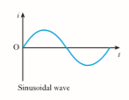

Slide 3

Sinusoidal wave:
A sinewave is defined by the trigonometric sine function. When plotted as voltage (V)/Current(I) as a function of phase (θ)/Time. The waveform repeats every 2∏ radians (360°). Voltage and current exhibiting cyclic behavior is referred to as alternating; i.e., alternating current (AC).
The basic equation for a sinewave is as follows:

Slide 4
Generation of an alternating e.m.f.
Figure below shows a loop AB carried by a spindle DD rotated at a constant speed in an anticlockwise direction in a uniform magnetic ﬁeld due to poles NS. The ends of the loop are brought out to two slip-rings C1 and C2, attached to but insulated from DD. Bearing on these rings are carbon brushes E1 and E2, which are connected to an external resistor R.

Slide 5
When the plane of the loop is horizontal, as shown in figure below, the two sides A and B are moving parallel to the direction of the magnetic ﬂux; it follows that no ﬂux is being cut and no e.m.f. is being generated in the loop.

Slide 6
Since the coil sides are moving in opposite directions, the e.m.f.s act in opposite directions, as shown by the dot and cross notation. However, they do act in the same direction around the coil so that the e.m.f. which appears at the brushes is twice that which is induced in a coil side. Once the coil reaches the 90°, the rate of cutting reaches a maximum.

Slide 7
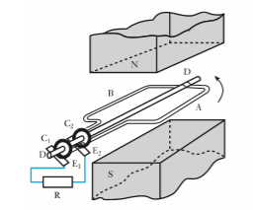

Slide 8
Thereafter the e.m.f falls to zero by the time the coil has rotated to the 180°. It follows that the variation of induced e.m.f. during the second half of the cycle of rotation is the same in magnitude as during the ﬁrst half but the polarity of the e.m.f. has reversed.

Slide 9
We can now analyse the general in which coil AB is shown after it has rotated through an angle θ from the horizontal position, namely the position of zero e.m.f. Suppose the peripheral velocity of each side of the loop to be u metres per second.

Slide 10
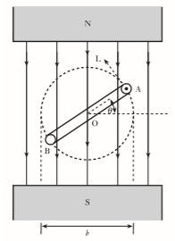

Slide 11
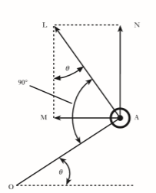

Slide 12

AL drawn at right angles to the plane of the loop. We can resolve AL into two components, AM and AN, perpendicular and parallel respectively to the direction of the magnetic ﬂux, as shown below.

Slide 13
The e.m.f. generated in A is due entirely to the component of the velocity perpendicular to the magnetic ﬁeld. Hence, if B is the ﬂux density in teslas and if l is the length in metres of each of the parallel sides A and B of the loop, it follows from expression that e.m.f. generated in one side of loop is

Slide 14
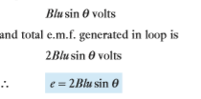

Slide 15
i.e. the generated e.m.f. is proportional to sinθ .
When θ = 90°, the plane of the loop is vertical and both sides of the loop are cutting the magnetic ﬂux at the maximum rate, so that the generated e.m.f. is then at its maximum value Em. From expression , it follows that when θ = 90°, Em = 2Blu volts. If b is the breadth of the loop in metres, and n the speed of rotation in revolutions per second, then u is π bn metres per second .

Slide 16
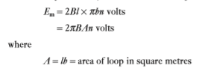

Slide 17
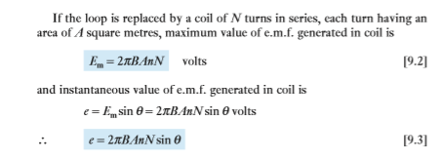

Slide 18
Lower-case letters are used to represent instantaneous values and uppercase letters represent deﬁnite values such as maximum, average or r.m.s. values.
In a.c. circuits, capital I and V without any subscript represent r.m.s. values . Em represents the maximum value of the e.m.f. and e is the value after the loop has rotated through an angle θ from the position of zero e.m.f.

Slide 19
When the loop has rotated through 180° or π radians, the e.m.f. is again zero. When θ is varying between 180° and 360° ( π and 2 π radians), side A of the loop is moving towards the right and is therefore cutting the magnetic ﬂux in the opposite direction to that during the ﬁrst half-revolution.

Slide 20
Hence, if we regard the e.m.f. as positive while θ is varying between 0 and 180°, it is negative while θ is varying between 180° and 360°, i.e. when θ varies between 180° and 270°, the value of the e.m.f. increases from zero to –Em and then decreases to zero as θ varies between 270° and 360°. Subsequent revolutions of the loop merely produce a repetition of the e.m.f. wave.

Slide 21
It is signiﬁcant that we have concentrated on one cycle of events arising from the single rotation of the coil AB. However, alternating e.m.f.s and alternating voltages continue to repeat the cycle.

Slide 22
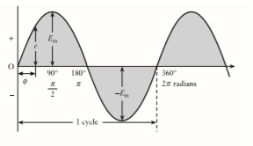

Slide 23
Waveform terms and deﬁnitions
Waveform. The variation of a quantity such as voltage or current shown on a graph to a base of time or rotation is a waveform.
Cycle. Each repetition of a variable quantity, recurring at equal intervals, is termed a cycle.
Period. The duration of one cycle is termed its period. (Cycles and periods need not commence when a waveform is zero.

Slide 24
Instantaneous value. The magnitude of a waveform at any instant in time (or position of rotation). Instantaneous values are denoted by lower-case symbols such as e, v and i.
Peak value. The maximum instantaneous value measured from its zero value is known as its peak value.
Peak-to-peak value. The maximum variation between the maximum positive instantaneous value and the maximum negative instantaneous value is the peak-to-peak value. For a sinusoidal waveform, this is twice the peak value. The peak-to-peak value is Epp or Vpp or Ipp.

Slide 25
Peak amplitude. The maximum instantaneous value measured from the mean value of a waveform is the peak amplitude. The peak amplitude is Em or Vm or Im. The peak amplitude is generally described as the maximum value, hence the maximum voltage has the symbol Vm. The relationships between peak value, peak-to-peak value and peak amplitude (maximum value) are illustrated in Fig. below

Slide 26
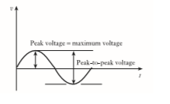

Slide 27

Frequency. The number of cycles that occur in 1 second is termed the frequency of that quantity. Frequency is measured in hertz (Hz). It follows that frequency f is related to the period T by the relation;

Slide 28
Average and r.m.s. values of an alternating current
Average Voltage (Vavg)/Average Current (Iavg)
As the name implies, Vavg is calculated by taking the average of the voltage in an appropriately chosen interval. In the case of symmetrical waveforms like the sinewave, a quarter cycle faithfully represents all four quarter cycles of the waveform. Therefore, it is acceptable to choose the first quarter cycle, which goes from 0 radians (0°) through p/2 radians (90°).

Slide 29
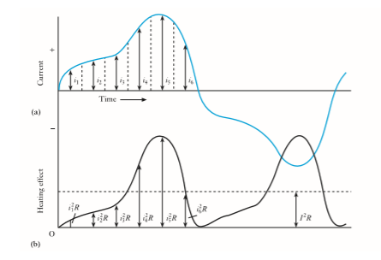

Slide 30


Or, alternatively, average value of current is

Slide 31
Root-Mean-Square Voltage (Vrms) / Root-Mean-Square Current(Irms)
As the name implies, Vrms is calculated by taking the square root of the mean average of the square of the voltage in an appropriately chosen interval. In the case of symmetrical waveforms like the sine wave, a quarter cycle faithfully represents all four quarter cycles of the waveform. Therefore, it is acceptable to choose the first quarter cycle, which goes from 0 radians (0°) through p/2 radians (90°). Vrms is the value indicated by the vast majority of AC voltmeters. It is the value that, when applied across a resistance, produces that same amount of heat that a direct current (DC) voltage of the same magnitude would produce.

Slide 32
In a.c. work, however, the average value is of comparatively little importance. This is due to the fact that it is the power produced by the electric current that usually matters. Thus, if the current represented in Fig. (a) is passed through a resistor having resistance Rohms, the heating effect of i1 is i2 1R, that of i2 is i2 2R, etc. as shown in Fig. (b). The variation of the heating effect during the second half-cycle is exactly the same as that during the ﬁrst half-cycle.

Slide 33
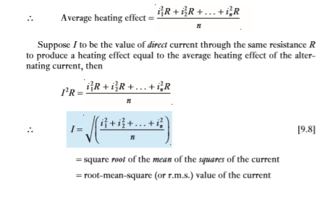

Slide 34
Since the average value of AC over a cycle is zero. For this reason, a more appropriate quantity is to be defined called Root mean square value of AC.
The root mean square value of AC is defined in terms of DC that does the same work at the same interval of time as it would be done by AC at the same time
Thus the rms value of AC is equivalent to that steady current which when passed through a resistor would produce the same heat that would be done by the AC in passing through the same resistor in similar condition.

Slide 35
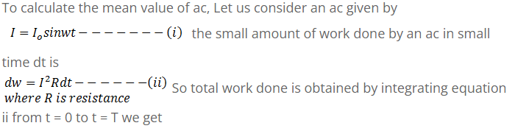

Slide 36
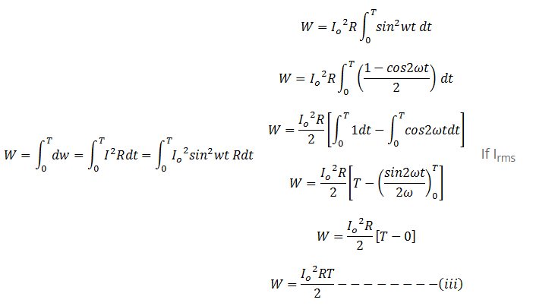

Slide 37
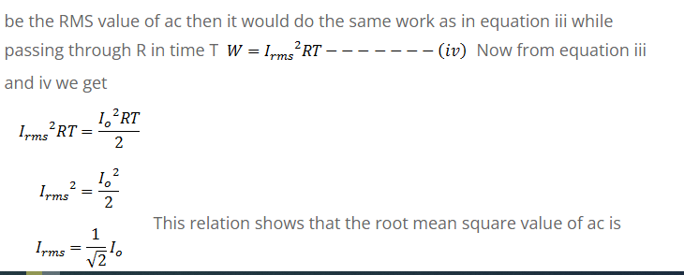

Slide 38
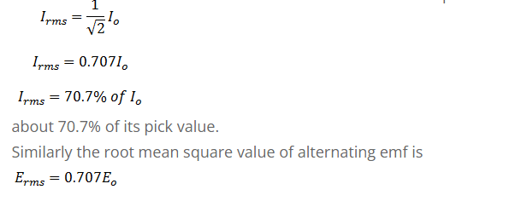

Slide 39
Average Voltage Analytical Method
As said previously, the average voltage of a periodic waveform whose two halves are exactly similar, either sinusoidal or non-sinusoidal, will be zero over one complete cycle.
Then the average value is obtained by adding the instantaneous values of voltage over one half cycle only. But in the case of an non-symmetrical or complex wave, the average voltage (or current) must be taken over the whole periodic cycle mathematically.

Slide 40
The average value can be taken mathematically by taking the approximation of the area under the curve at various intervals to the distance or length of the base and this can be done using triangles or rectangles as shown.

Slide 41
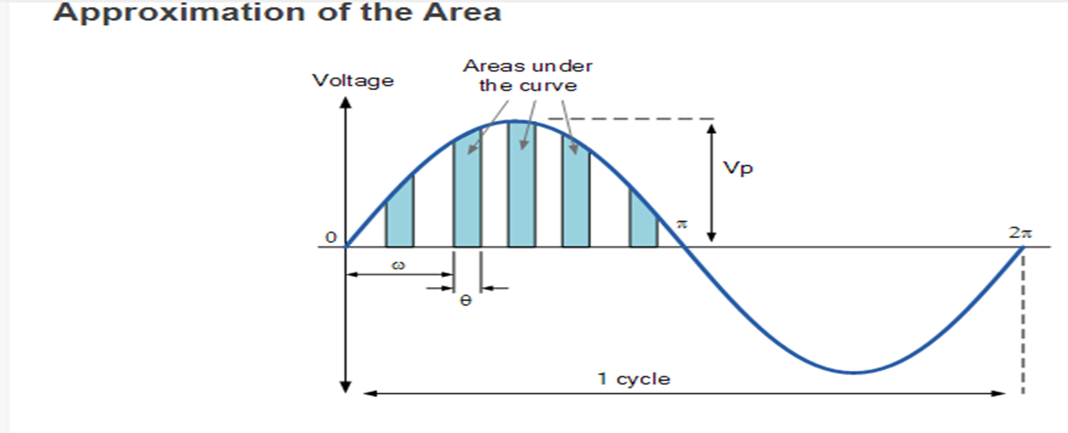
By approximating the areas of the rectangles under the curve, we can obtain a rough idea of the actual area of each one. By adding together all these areas the average value can be found. If an infinite number of smaller thinner rectangles were used, the more accurate would be the final result as it approaches 2/π.

Slide 42

The area under the curve can be found by various approximation methods such as the trapezoidal rule, the mid-ordinate rule or Simpson’s rule. Then the mathematical area under the positive half cycle of the periodic wave which is defined as V(t) = Vp.cos(ωt) with a period of T using integration is given as:

Slide 43
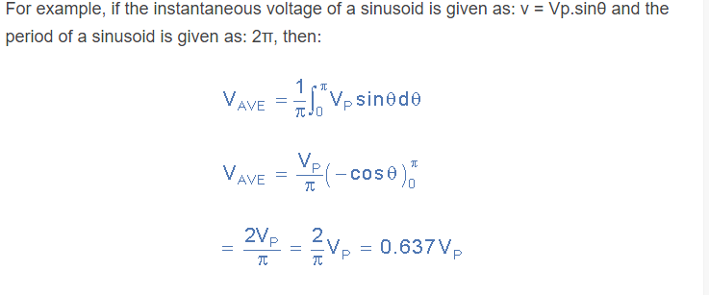
Then the area below the curve is finally given as Area = 2VP. Since we now know the area under the positive (or negative) half cycle, we can easily determine the average value of the positive (or negative) region of a sinusoidal waveform by integrating the sinusoidal quantity over half a cycle and dividing by half the period.

Slide 44
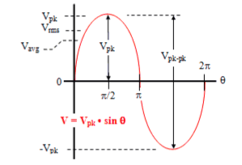

Slide 45
There are a number of ways in which the amplitude of a sinewave is referenced, usually as peak voltage (Vpk or Vp), peak-to-peak voltage (Vpp or Vp-p or Vpkpk or Vpk-pk), average voltage (Vav or Vavg), and root-mean-square voltage (Vrms). Peak voltage and peak-to-peak voltage are apparent by looking at the above plot. Root-mean-square and average voltage are not so apparent.

Slide 46

Form factor:
Two alternating periodic waveforms of the same amplitude and frequency may look different depending upon their wave shape/form and then their average & RMS values will be different. In order to compare such different waveforms of the same frequency and amplitude but of different wave shape a parameter called Form factor is defined as the ratio of it’s RMS and Average values. For a sinusoidal signal of peak voltage Vm it is given by :

Slide 47
J notation:
The mathematics used in Electrical Engineering to add together resistances, currents or DC voltages use what are called “real numbers” either as integers or as fractions. But real numbers are not the only kind of numbers we need to use especially when dealing with frequency dependent sinusoidal sources and vectors.
Numbers were introduced to allow complex equations to be solved with numbers that are the square roots of negative numbers, √-1.
In electrical engineering this type of number is called an “imaginary number” and to distinguish an imaginary number from a real number the letter “ j ” known commonly in electrical engineering as the j-operator, is used. The letter j is placed in front of a real number to signify its imaginary number operation

Slide 48
The horizontal axis is called the “real axis” while the vertical axis is called the “imaginary axis”. The real and imaginary parts of a complex number are abbreviated as Re(z) and Im(z), respectively.

Slide 49
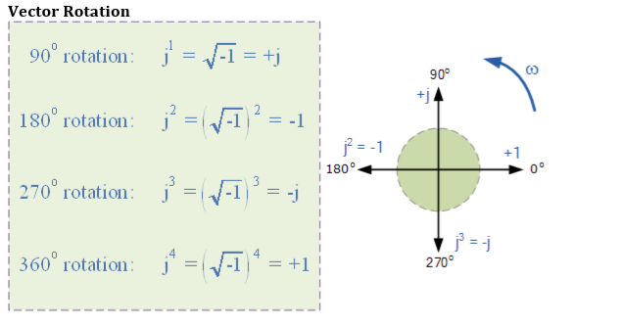

Slide 50
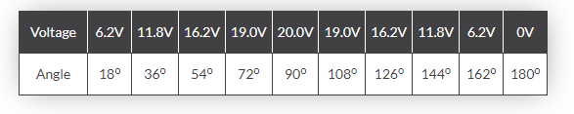
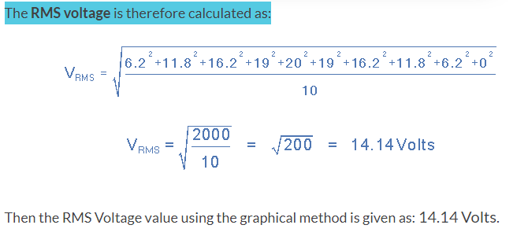
WORKED EXAMPLES
Consider the data below
Find the rms voltage .
Soln:
soln

Slide 51
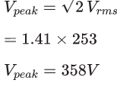
The mains voltage can vary between 216 and 253 volts. These are r.m.s. values,Calculate the maximum possible voltage from a mains socket the peak voltage for 253 volts r.m.s.
SOLN:

Slide 52
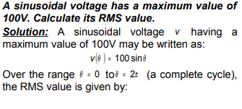

Slide 53
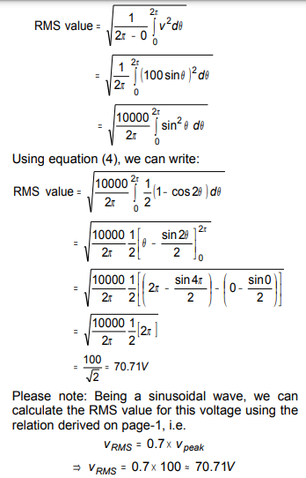

Slide 54
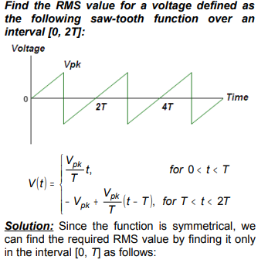

Slide 55
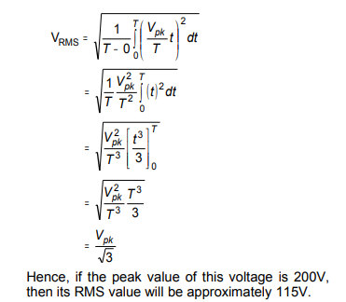

Slide 56
THANK YOU

